Slide 1
iPhone Product Review

Slide 2

Agenda
Project Objective
Data Schema
Limitations
Product Analytics
Business Insights

Slide 3

Project Objective
Analyze customer review data across multiple iPhone Models to understand whether Apple considers customer preferences when making decisions
Extract what Apple customers value most in the iPhone

Slide 4
Data Schema
iPhone 8, iPhone X, iPhone 11, iPhone 11 Pro Max review data from 2017 September to 2020 February
Up to 3,000 review data per iPhone model, and 10,748 data in total
Dataset includes: index number, review headings, review texts, rating, time, type

Slide 5
Limitations
All reviews were scrapped from Best Buy, but most people purchase iPhones from Apple official website or physical stores
Imbalanced data: nearly 80% of reviews are positive
(Apple removed product reviews late last year)

Slide 6

Product Analytics

Slide 7
Key features of each iPhone model
Model | iPhone 8 | iPhone X | iPhone 11 | iPhone 11 Pro Max
Display | 4.7 Retina HD | 5.8" Super Retina HD | 6.1’’ Liquid Retina HD | 6.5’’ Super Retina XDR
Screen | 4.7’’ Widescreen LCD | 5.8’’ All-screen OLED | 6.1’’ All-screen LCD | 6.5’’ All-screen OLED
Processor | A11 processor | A11 Bionic processor | A13 Bionic processor | A13 Bionic processor
Camera | Single 12MP Wide | Dual 12MP Wide | Dual 12MP Ultra Wide | Triple 12MP Ultra Wide
Battery | Same as iPhone 7 | 2 hrs longer than iPhone 7 | 2.5 hrs longer than iPhone 7 | 6.5 hrs longer than iPhone 7
Secure Authentication | Touch ID | Facial Recognition | Facial Recognition | Quicker Facial Recognition
Home Button | Home Button | No Home Button | No Home Button | No Home Button
Water Resistance | 1m | 1m | 2m | 4m
Color | 3 colors | 2 colors | 6 colors | 4 colors
Notes:
iPhone 8 lost headphone jack and added wireless charging
From official website
Whether there features are liked or accepted by customers
Which feature is discussed most by them

Slide 8
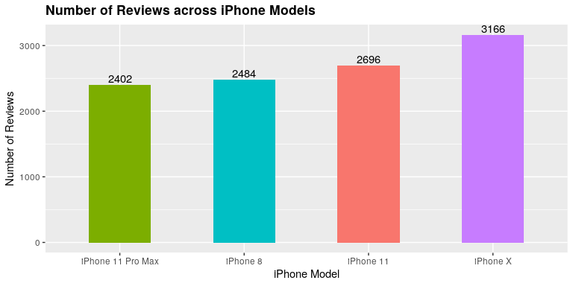
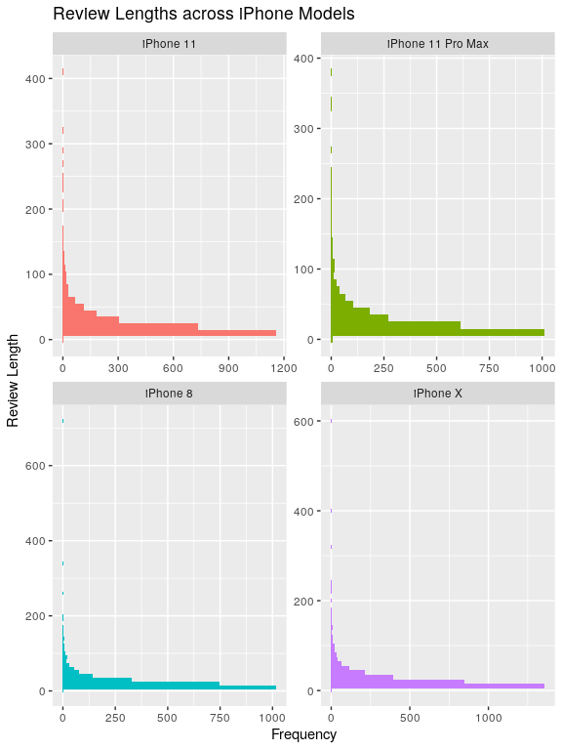
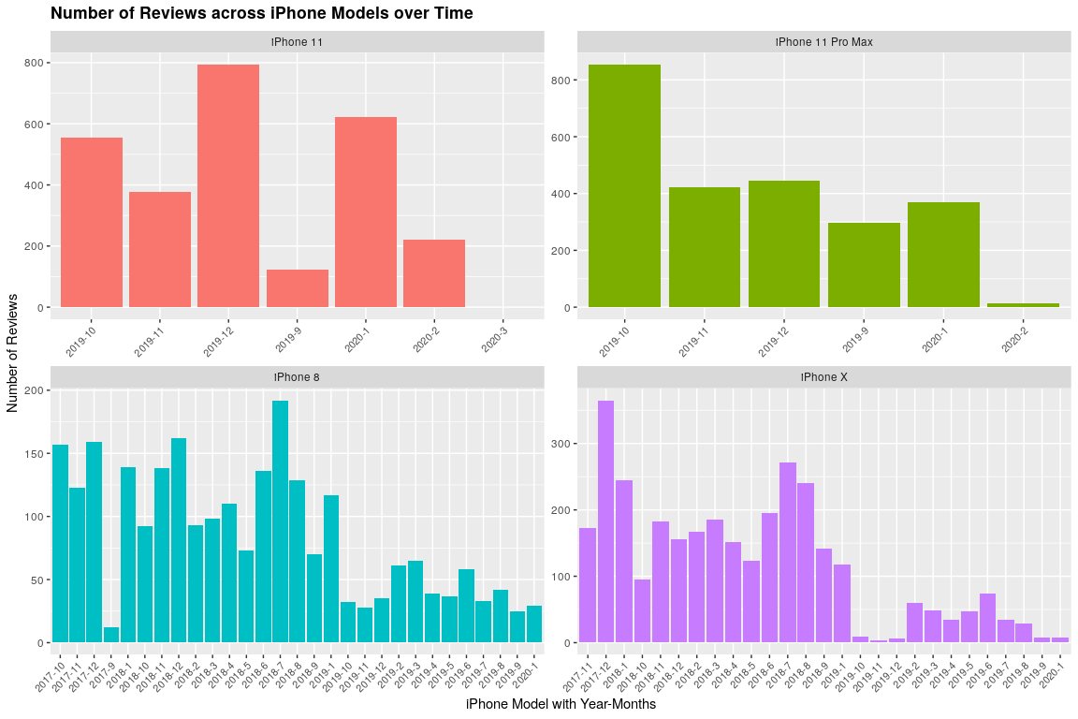
Data Exploration
Notes:
Histogram has 10 binwidth
Most reviews are short, less than 50 words
Iphone X is the most innovative one compare to previous models
11 pro max is the newest one

Slide 9
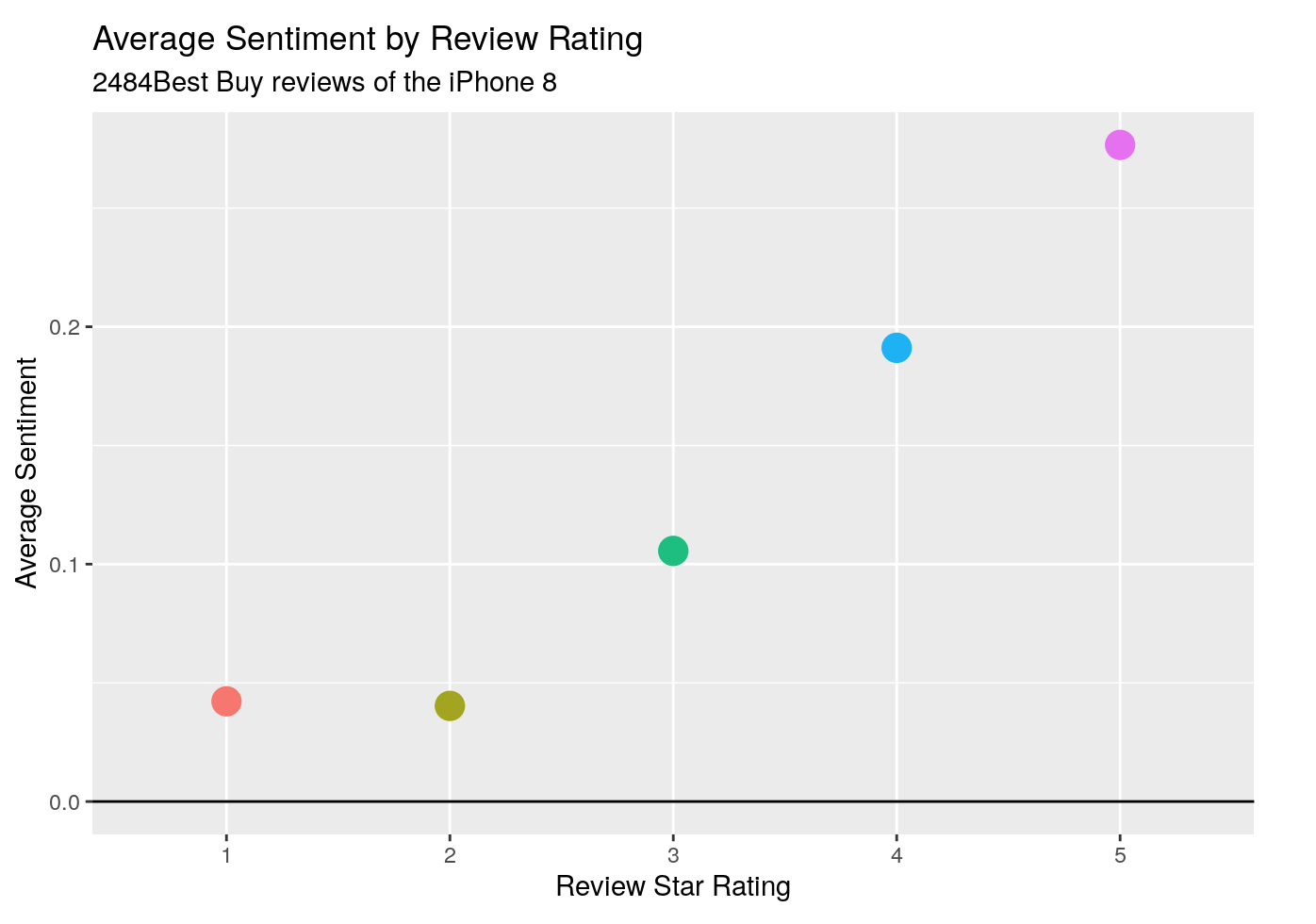
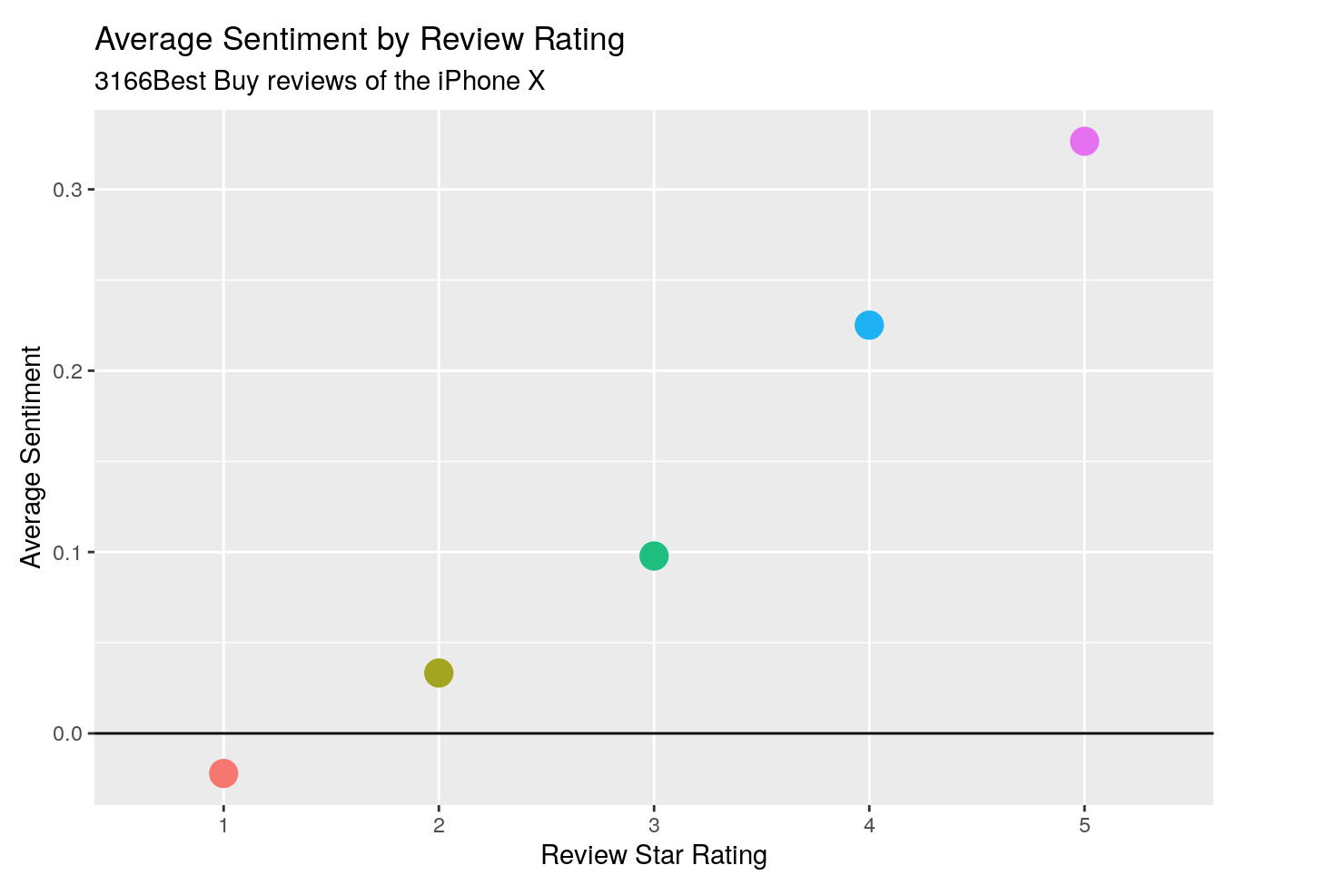
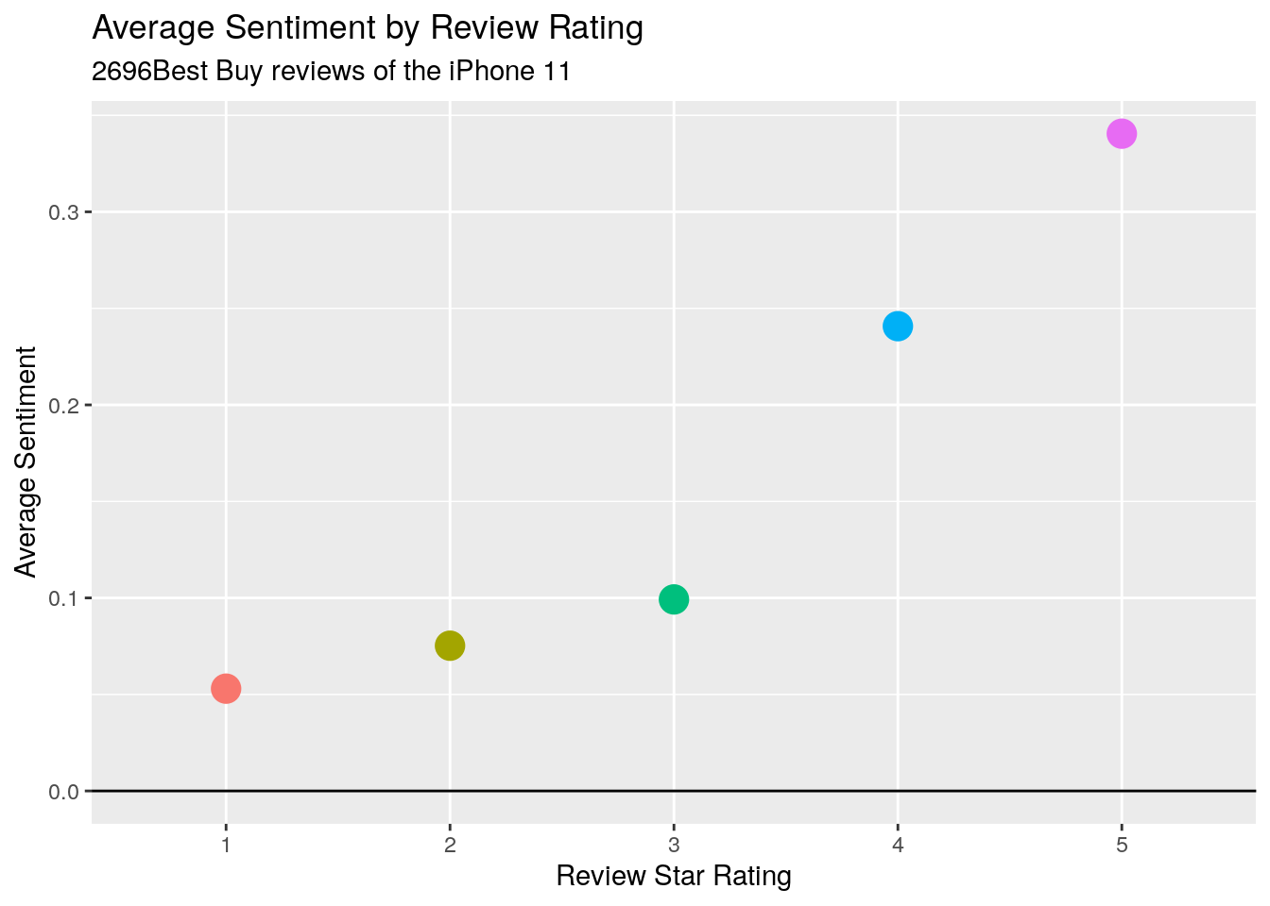
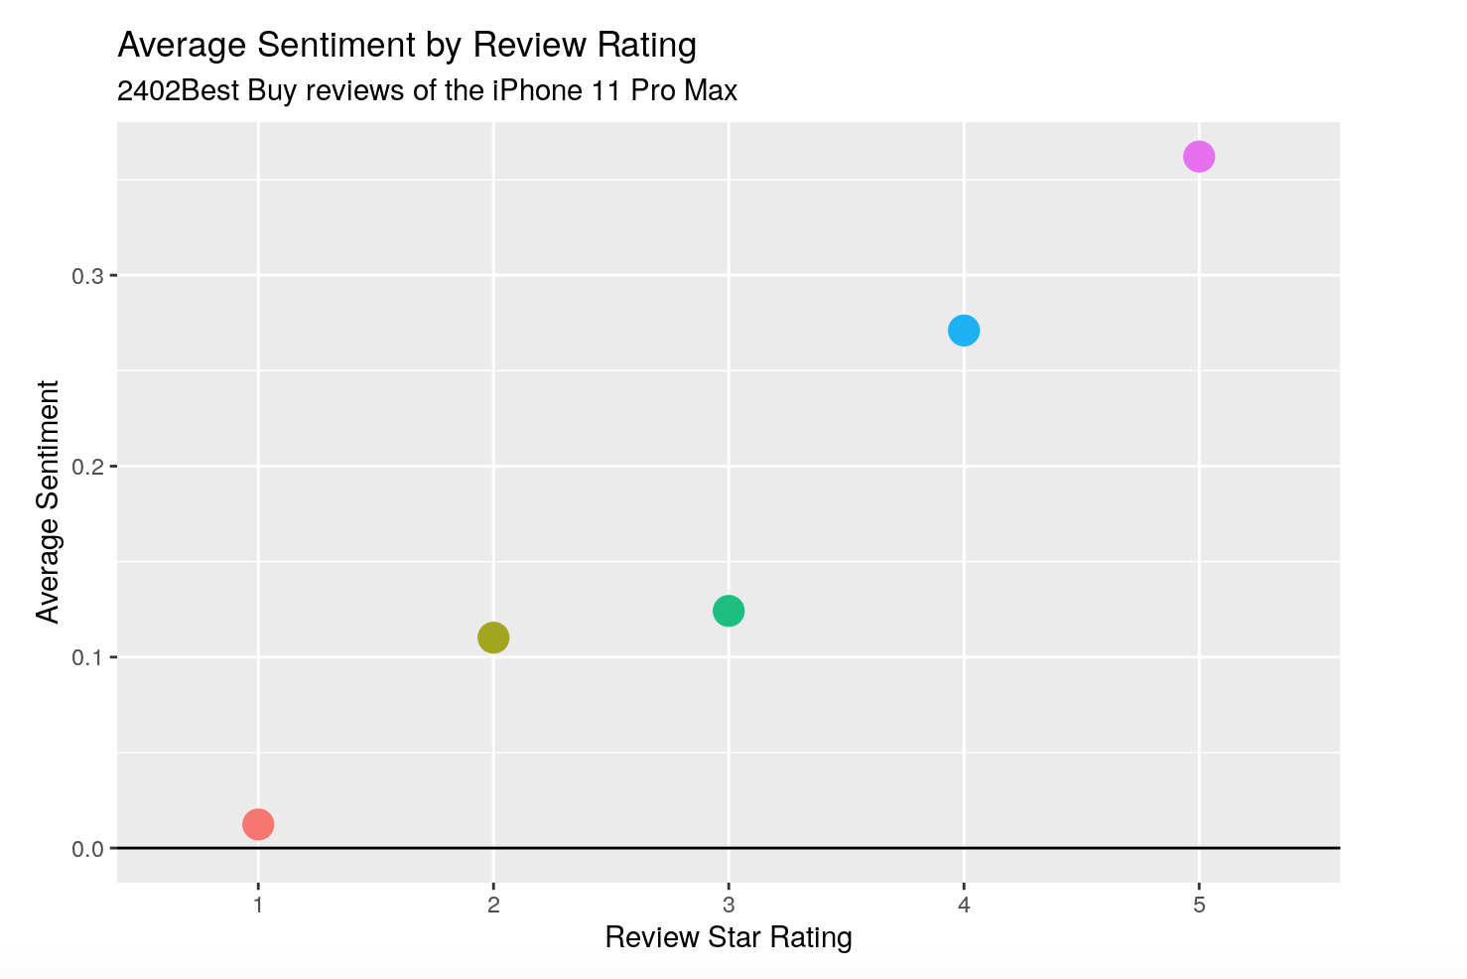
Sentiment Analysis
As review rating increases, the average sentiment also increases.
Notes:
General sentiment analysis
Make sure dataset is reasonable and reliable
The higher the rating, the more positive people’s attitude is

Slide 10
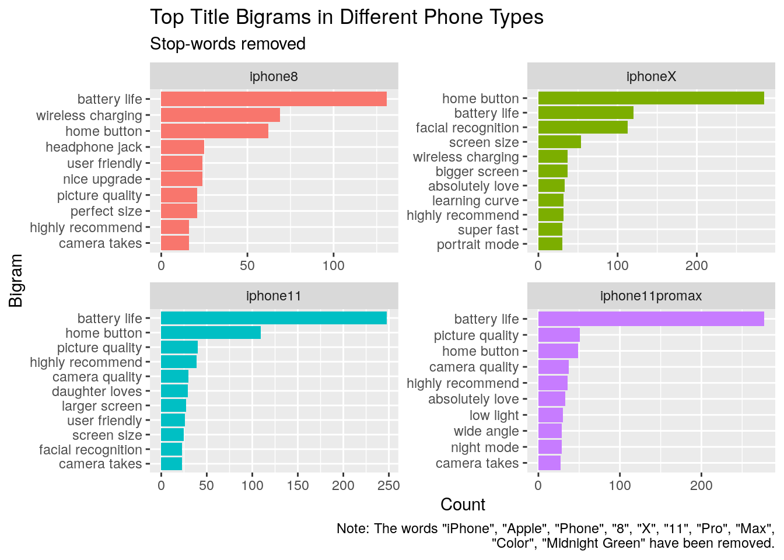
Summarizing Text
Top Common Bigrams
Battery Life
Home Button
Top Different Bigrams
Wireless charging
Facial recognition
Picture quality
Camera quality
Notes:
Histogram has 10 binwidth
Remove some words first to make the analysis simpler.
Midnight green color is one of the features for 11 and pro max, people talked a lot about it so that it appears several times in reviews
Common topics
Different topics, indicating the most notable and essential features for each generation
Begin with these remarkable features

Slide 11
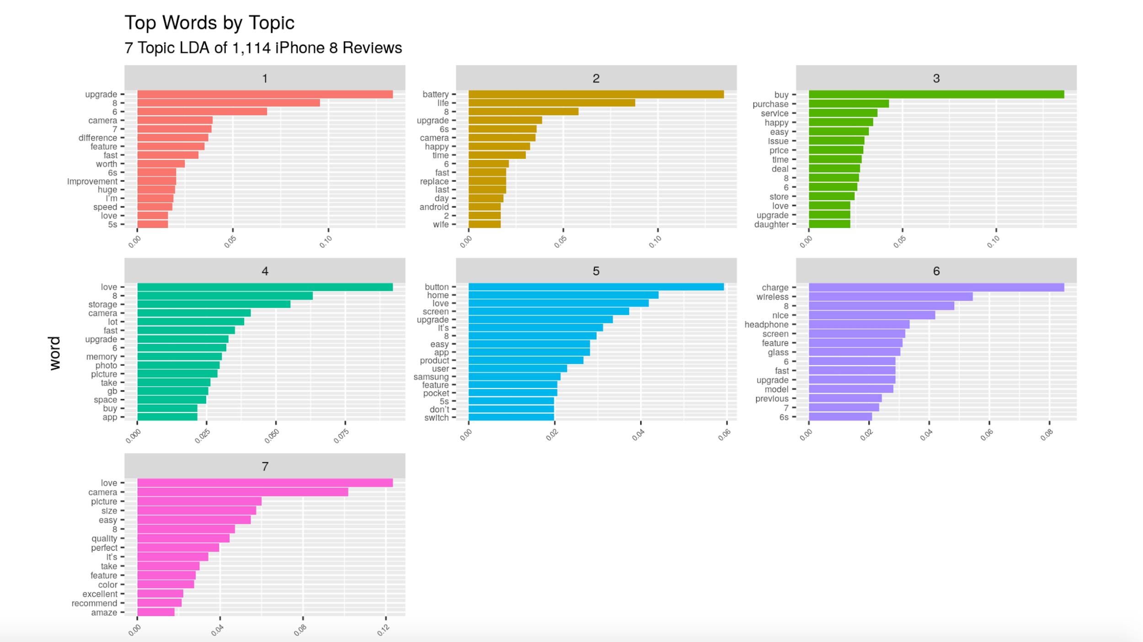
iPhone 8 - Topic Model

Slide 12
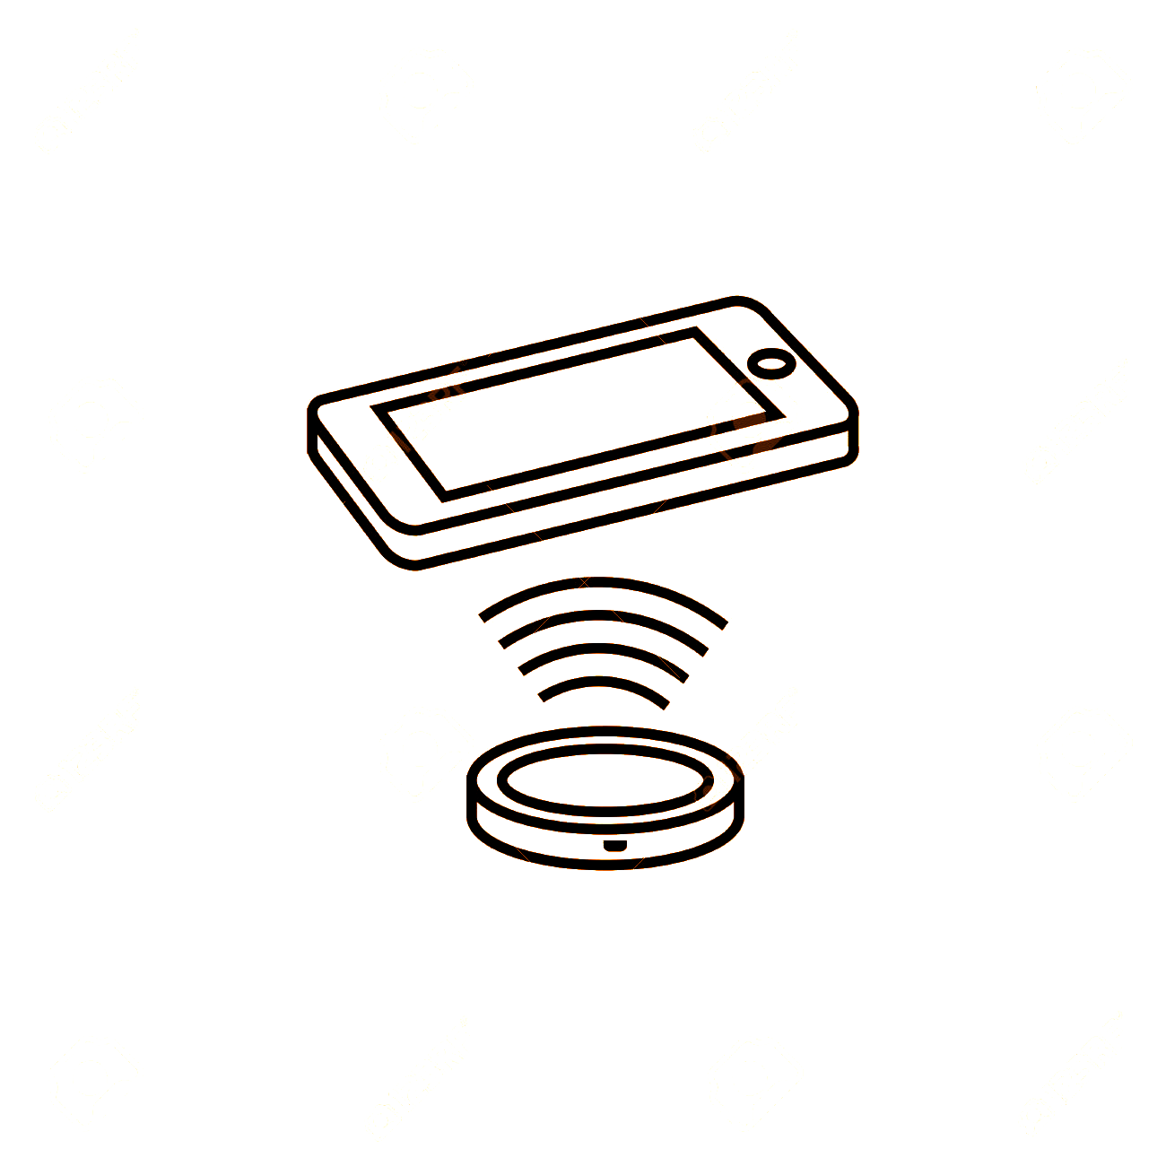
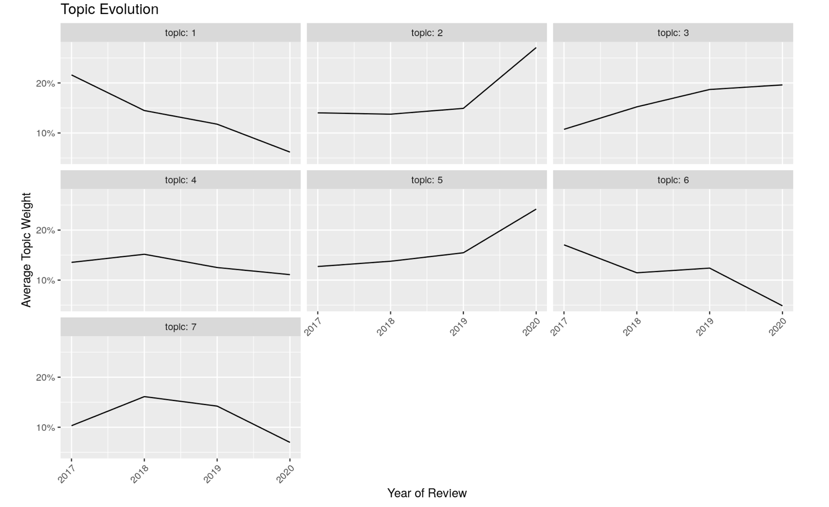
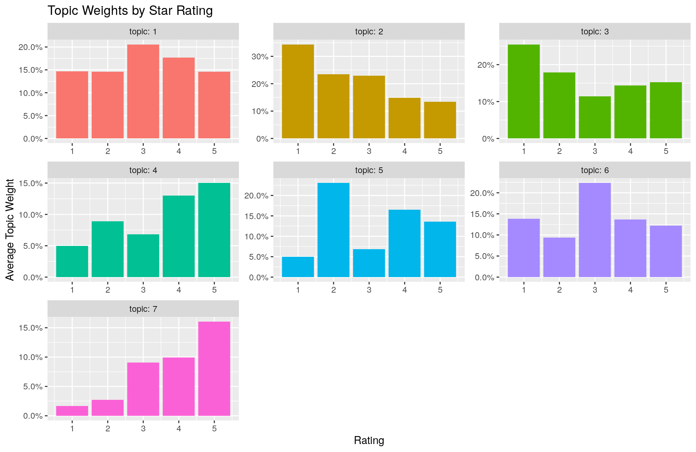
iPhone 8 — Wireless Charging
Lost massive focus in 2017, slightly gained back some interest but dropped again in 2019.
This new function is not flattering to most buyers.

Slide 13
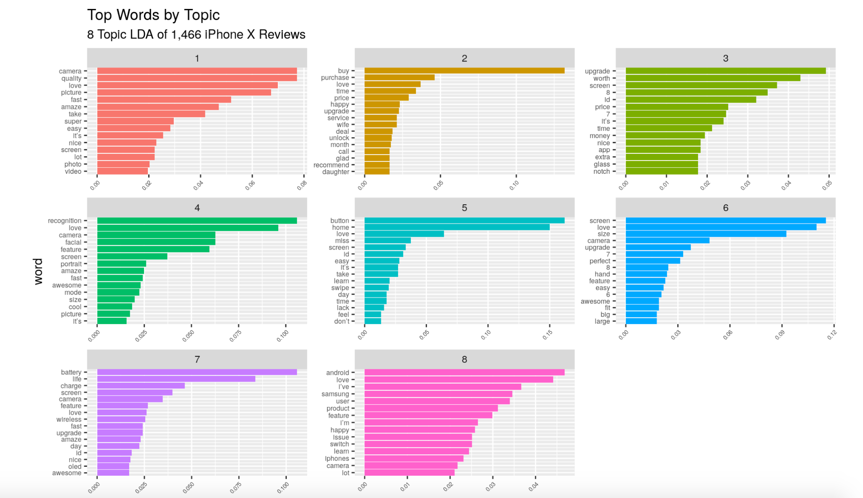
iPhone X — Topic Model

Slide 14

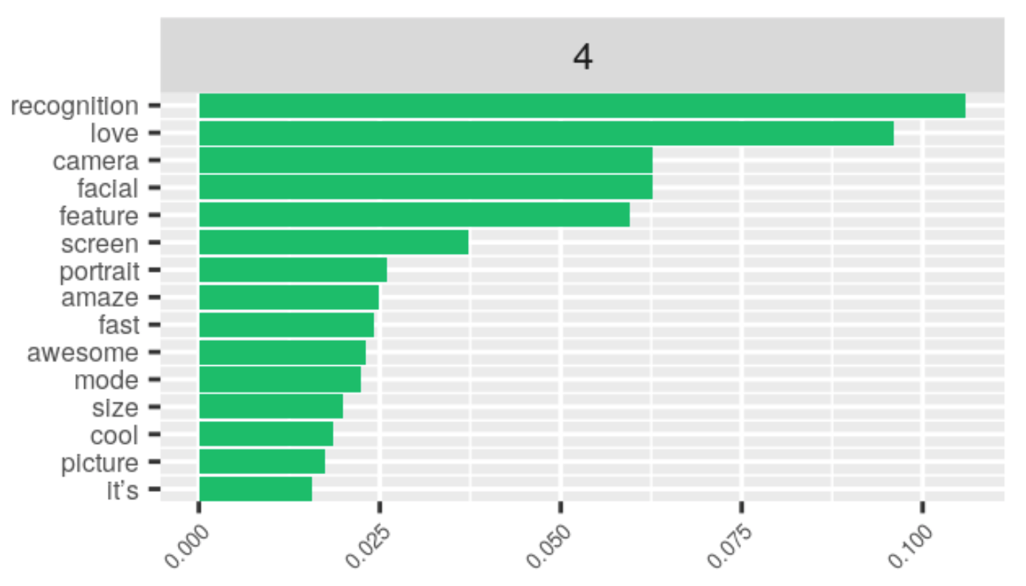
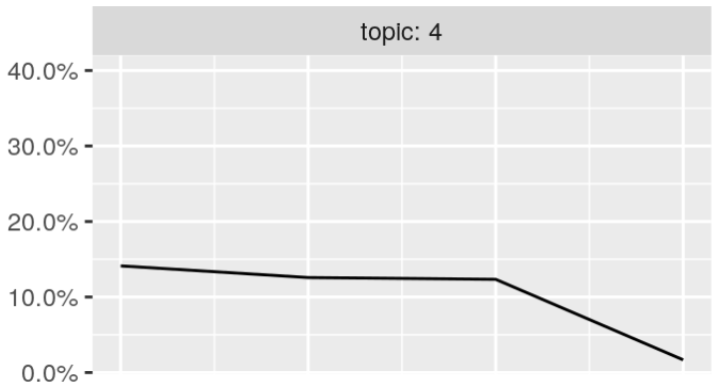

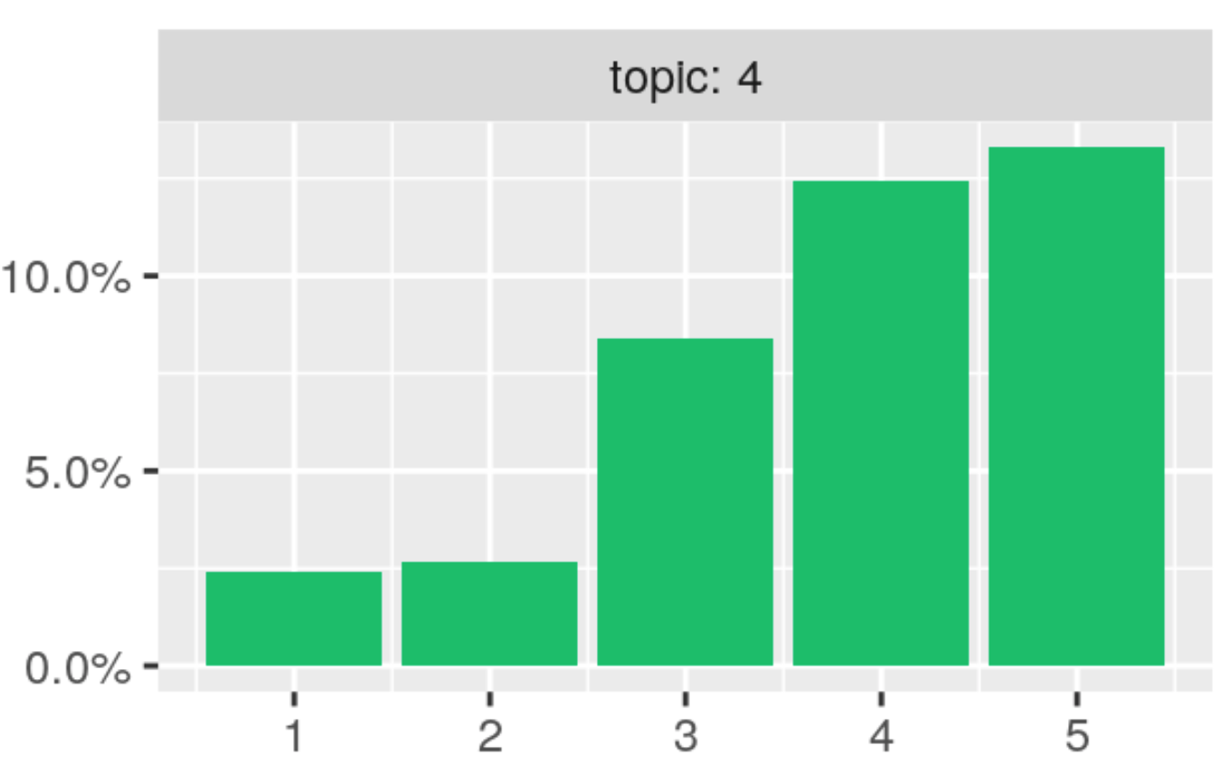
iPhone X — Facial Recognition
Gradually lost focus throughout 2017 & 2018, then sharply dropped in 2019.
This new function is highly favoured by most of users.

Slide 15
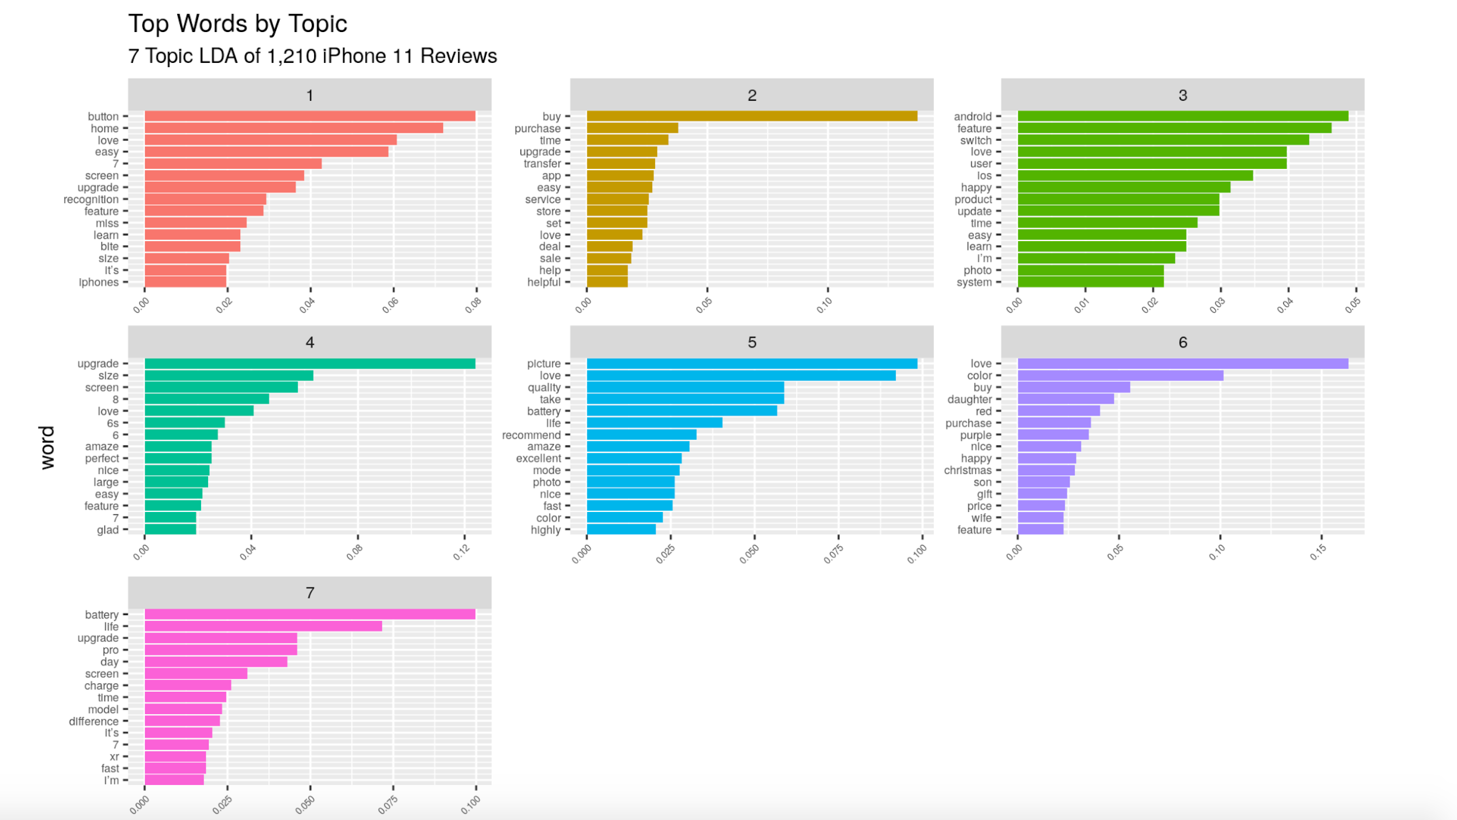
iPhone 11 — Topic Model

Slide 16

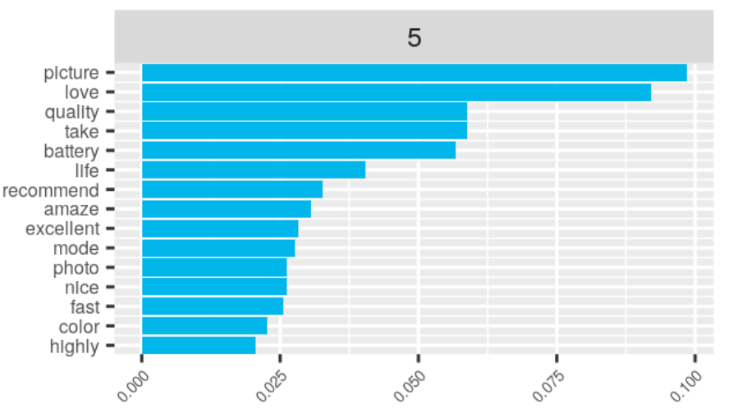
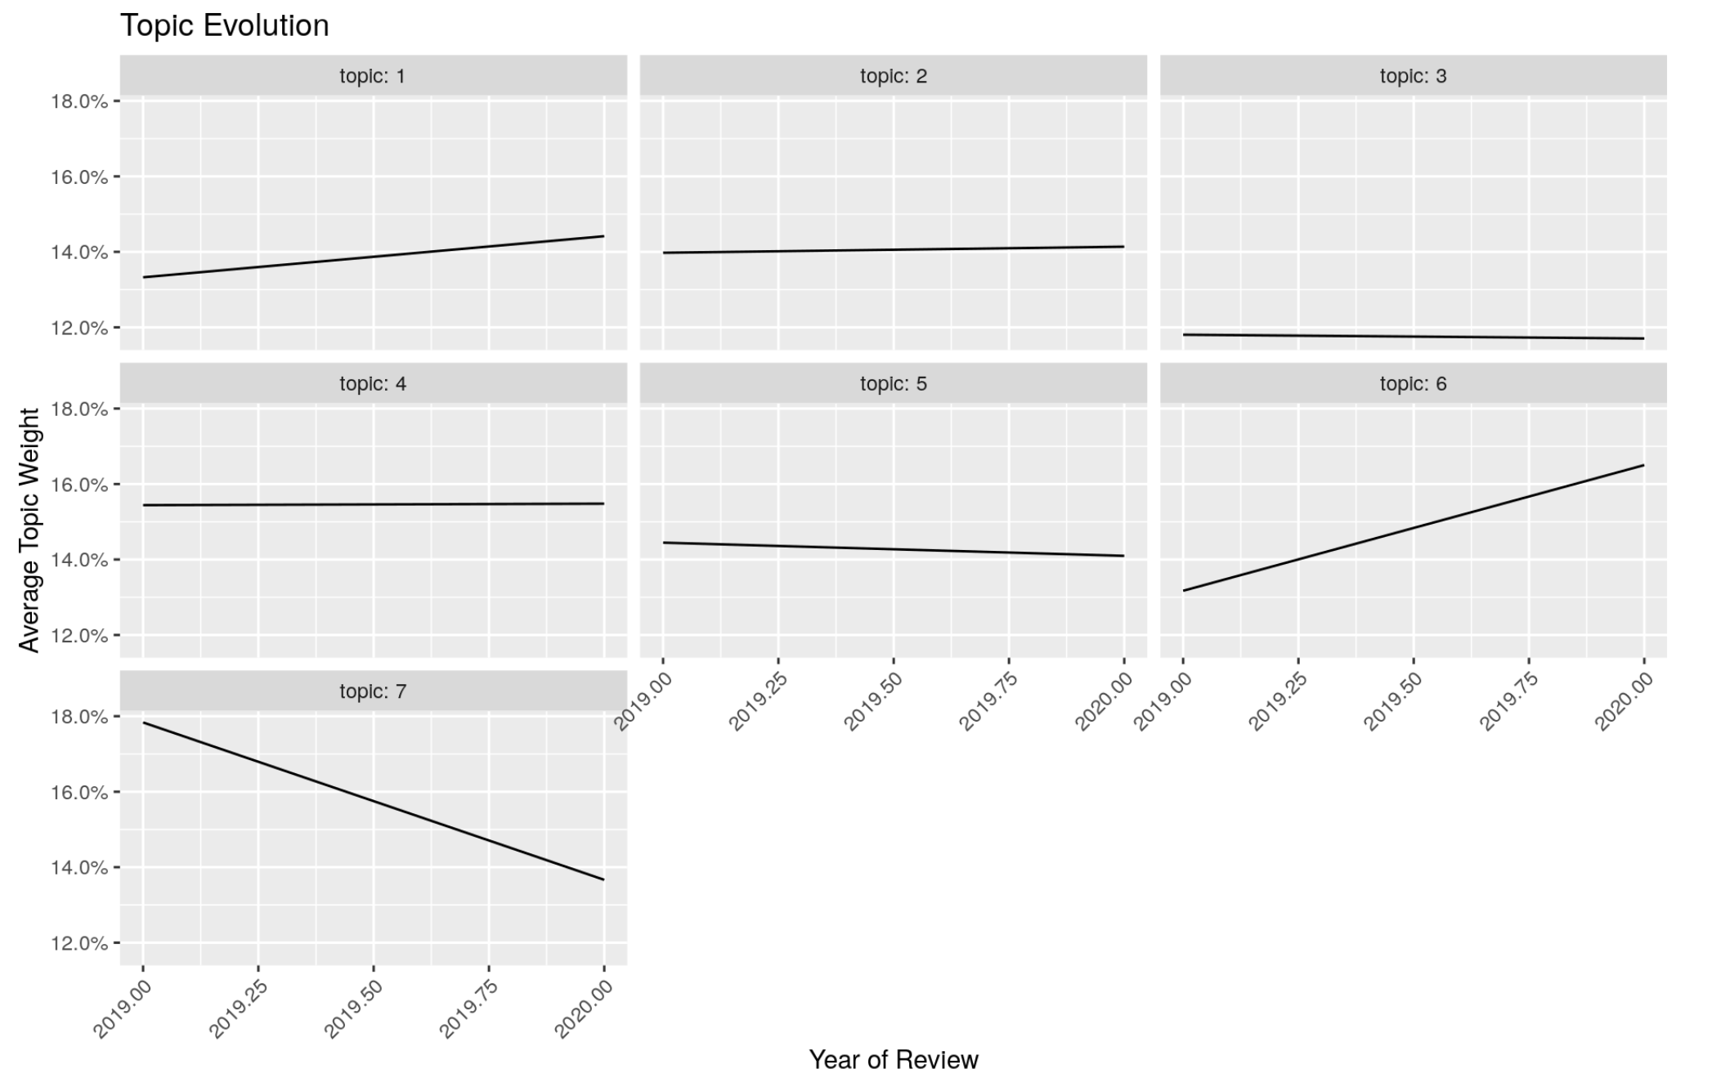
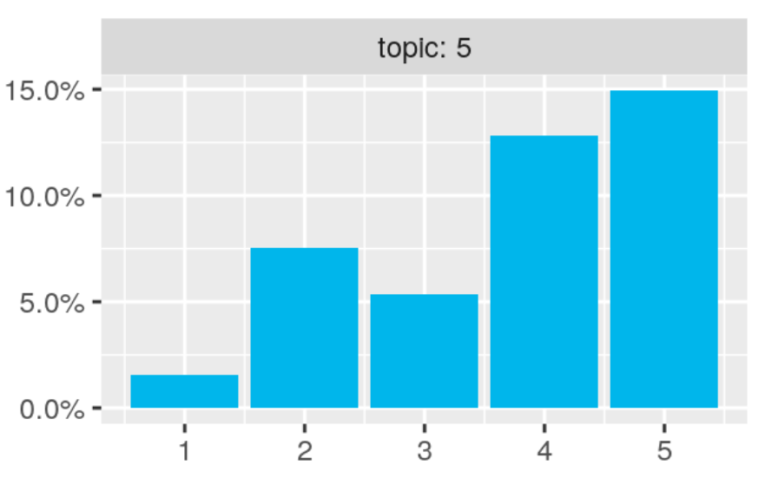
iPhone 11 — Picture Quality
Slightly lost focus throughout 2019.
Most people are highly satisfied with the picture quality.

Slide 17


digital camera
night mode of iPhone 11
(Photo courtesy of Amanda Zhao)

Slide 18
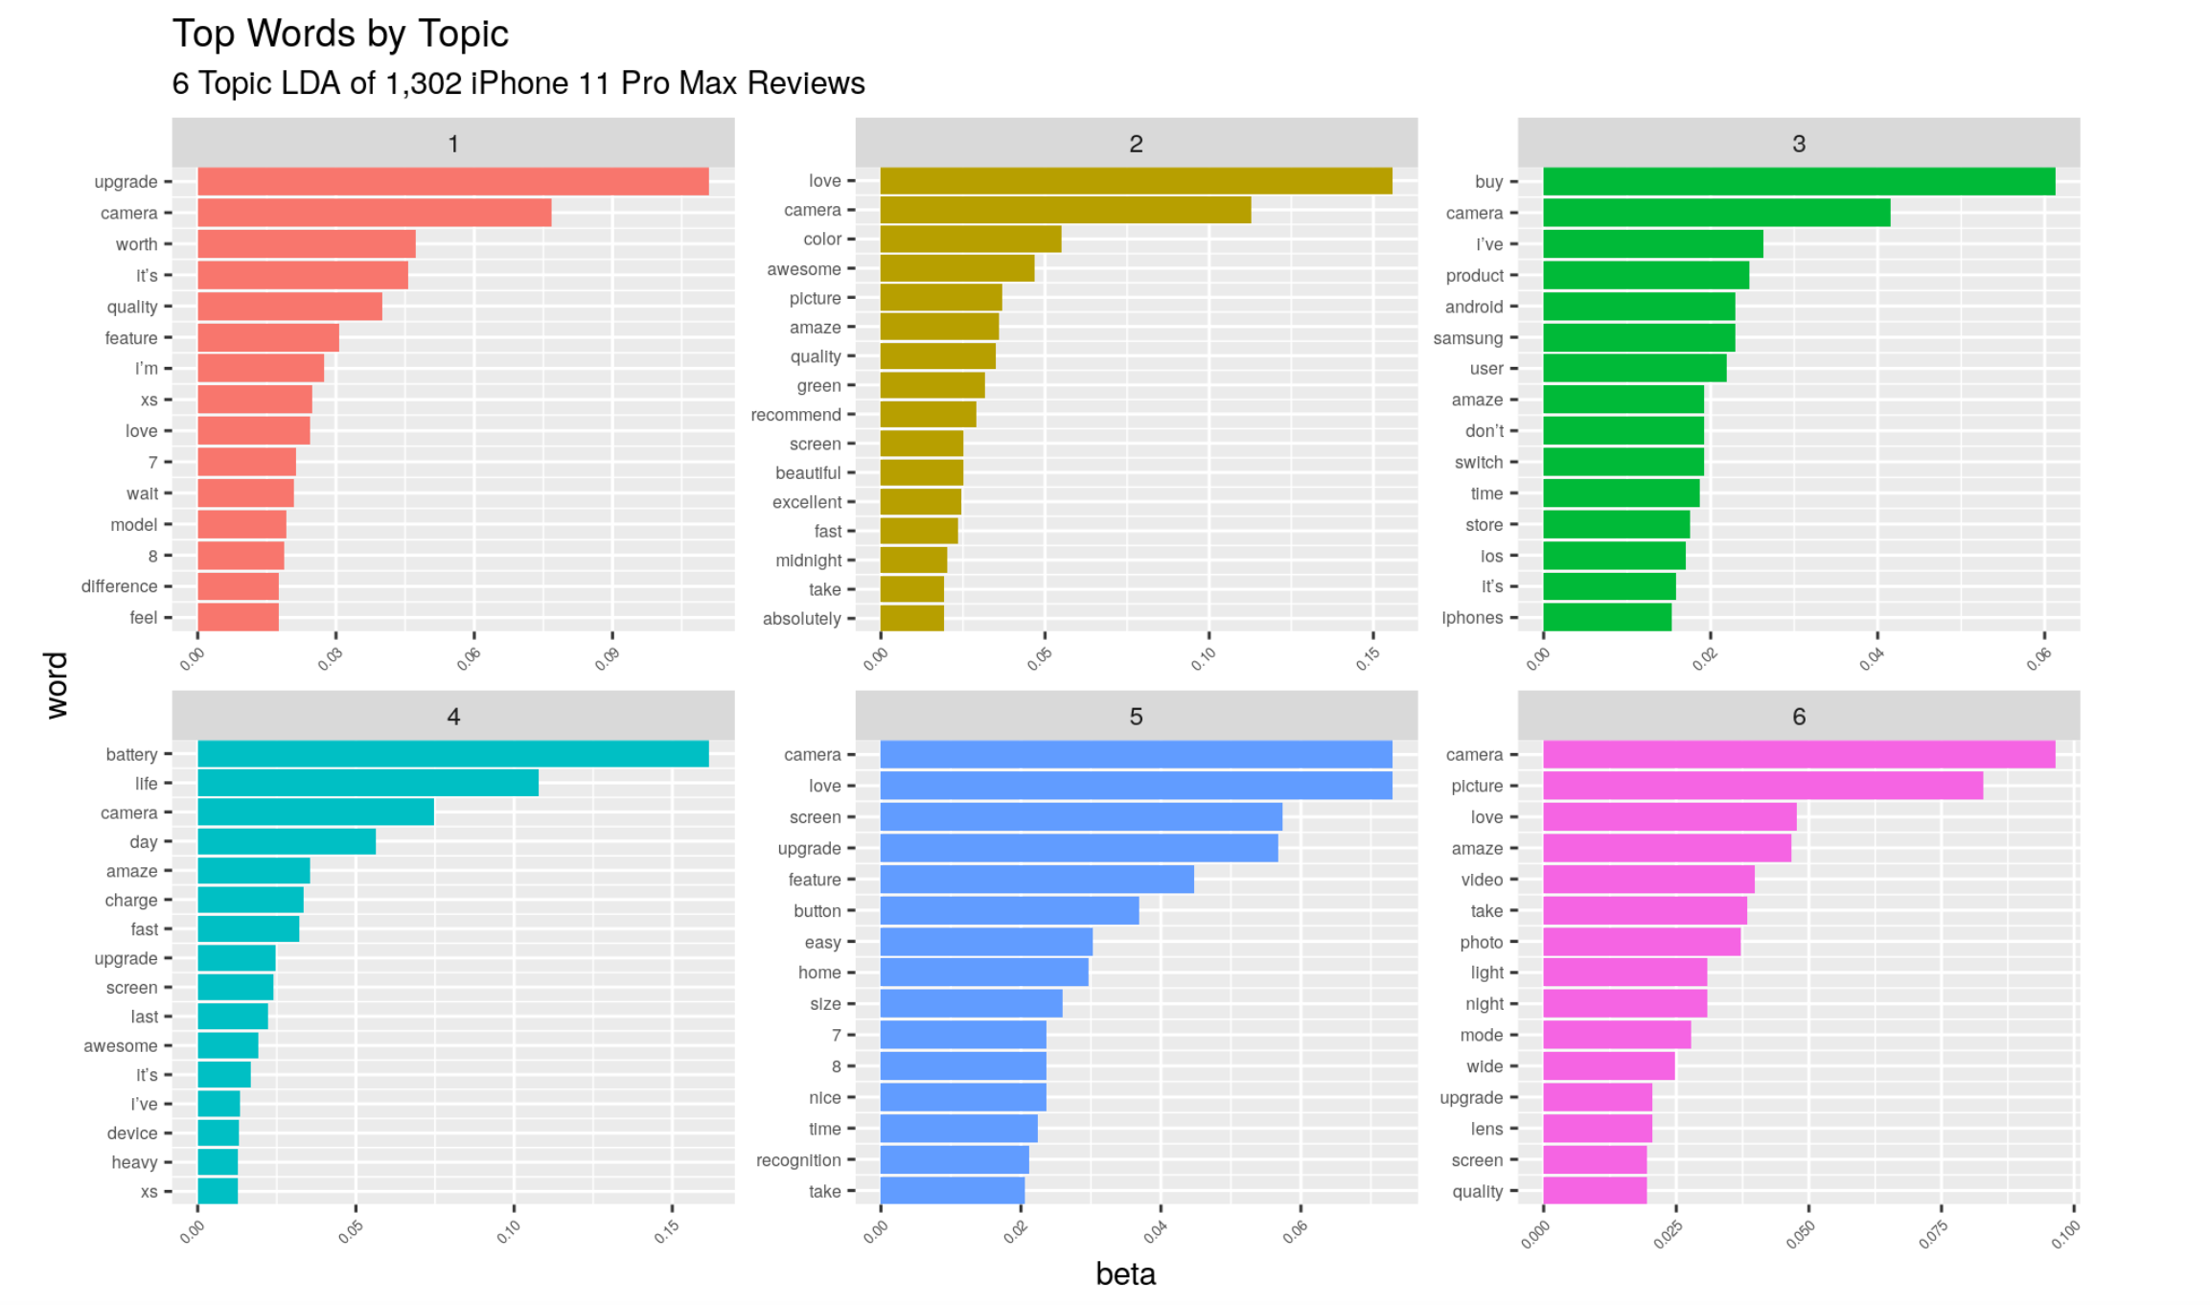
iPhone 11 Pro Max — Topic Model

Slide 19

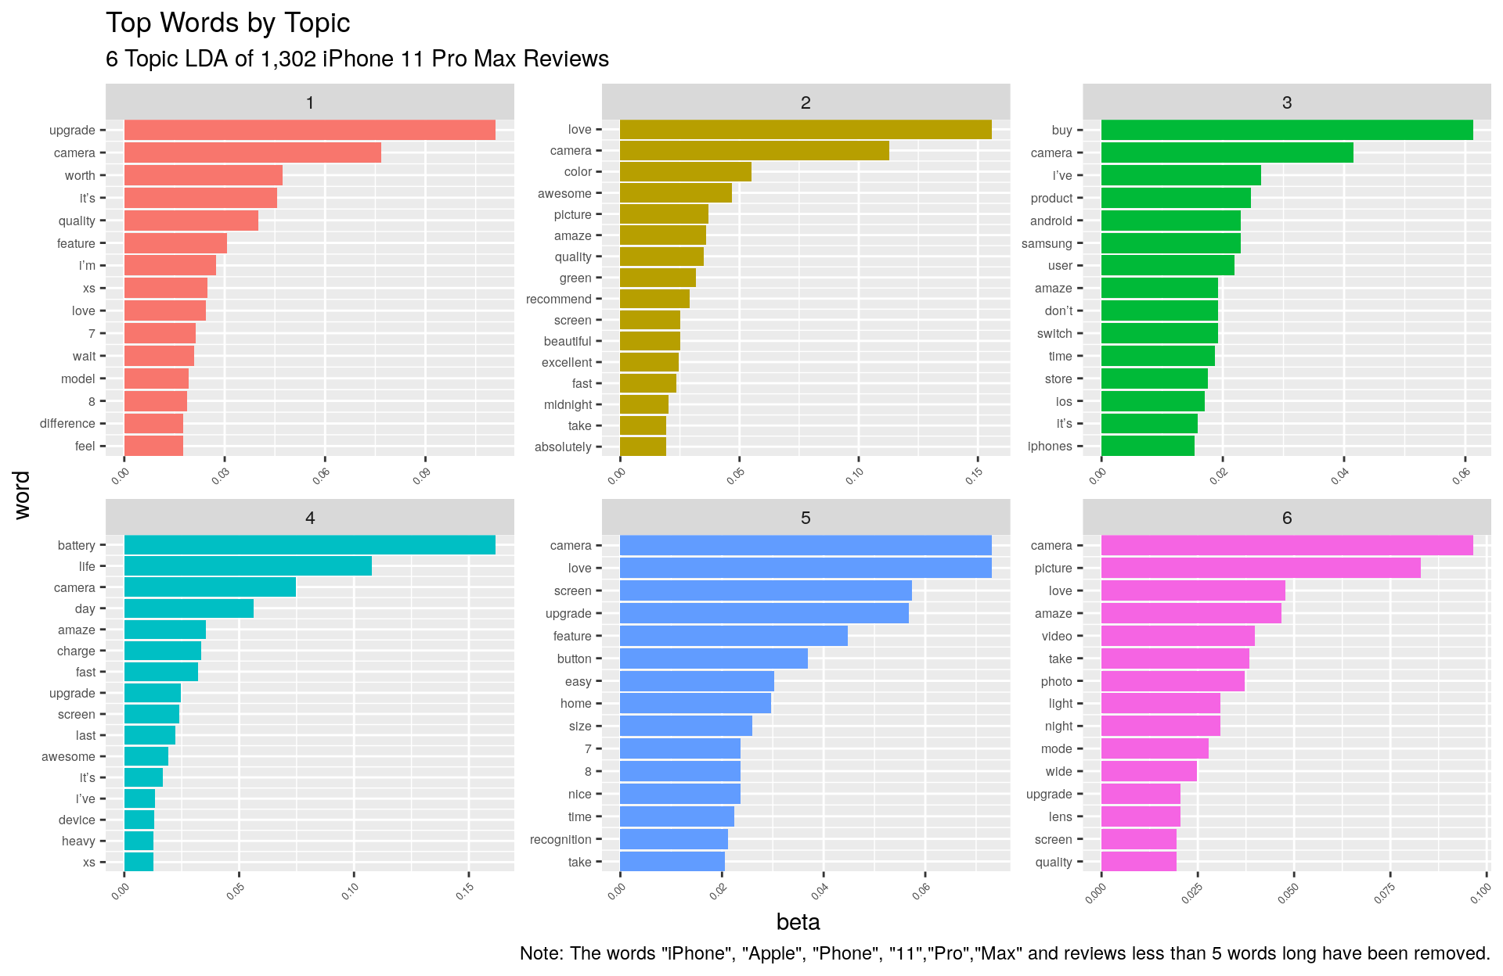
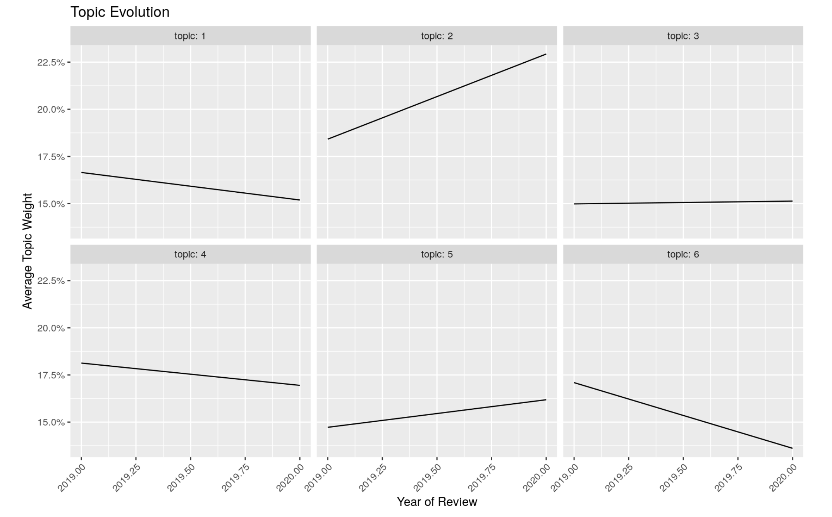
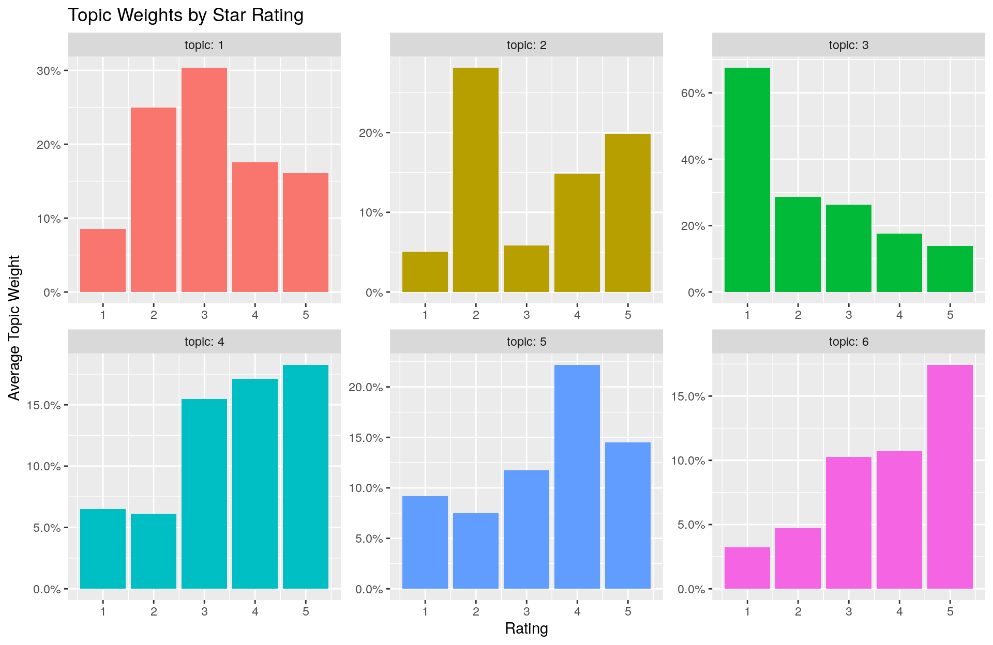
iPhone 11 Pro Max — Camera Functionality
Gradually lost focus throughout 2019.
Camera functionality is significantly improved.

Slide 20

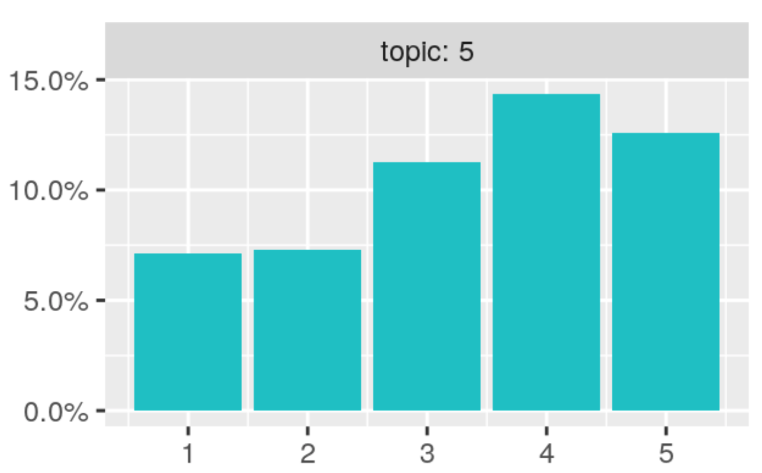
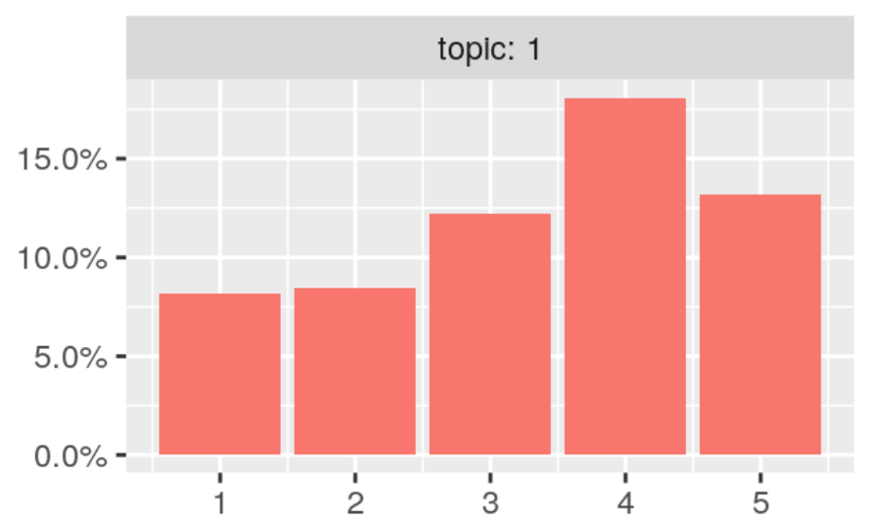
Home Button
iPhone 8
iPhone X
iPhone 11
Home Button is controversial for iPhone 8.
Most people are satisfied with the no-home button designed iPhone X and iPhone 11.

Slide 21

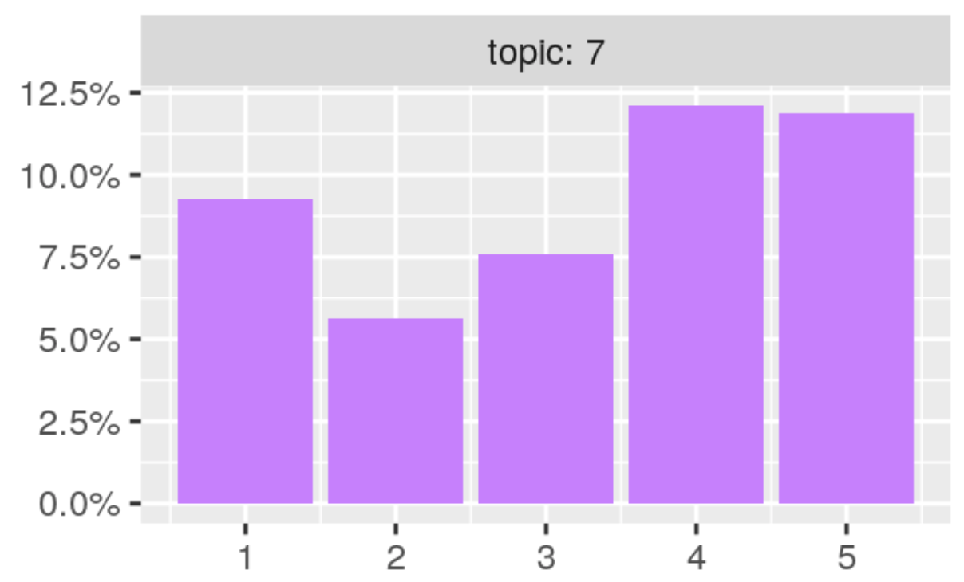
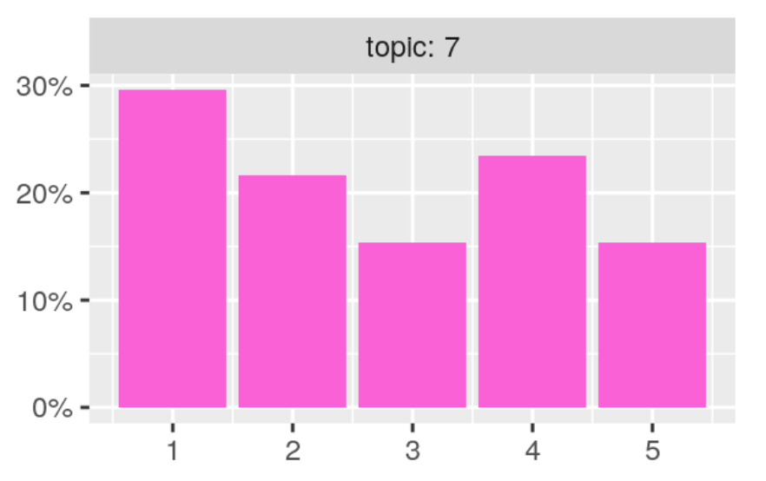
Battery Life
iPhone 8
iPhone X
2 hrs longer than iPhone 8!!
iPhone 11
iPhone 11 Pro Max
Only 0.5 hr longer than iPhone X!!
4.5 hrs longer than iPhone X!!

Slide 22

Business Insights

Slide 23
Insights
Apple takes customer opinions into account for overall strategy
The majority of iPhone users value on battery life and camera
iPhone customers like having many color choices
Notes:
We initially wanted to see if Apple takes into account customer opinions in reviews when producing new iPhones. In the end we found that, yes, Apple does care about customer opinion and improves the things most important to customers, insomuch that they, in large part, adjust their overall strategy to give customers what they want. However, while giving customers what they want, Apple also keeps in mind Steve Jobs’ idea that “People don’t know what they want until you show it to them”. For example, in late 2017, we saw Apple release both the iPhone 8 and iPhone X within 2 months of each other with the removal of the home button and the addition of Face ID being one of the big differences between the 2. Why did they do this? Like us, Apple saw that their customers still valued the home button, however, they also wanted to introduce their new advanced Face ID feature. They showed customers a new feature they didn’t know they wanted while also keeping loyal customers that loved the home button. Now Face ID is loved by most iPhone users instead of using the Home Button.
Apple strategy : Released 8 and X at the same time to gauge customers’ reaction to removal of Home Button and replacement of new Face ID Feature
About 30% of reviews that mention the iPhone 8 home button had star rating at 1 or 2. From examining some of the negative reviews, it seems that these people dislike the new haptic feedback home button compared to the old “clickable” home button.

Slide 24
Recommendations
Release iPhones with button and no-button products together
Continue improving battery life and camera
Wireless charging: No longer needs improvement
More colors

Slide 25
Thank you!!

